Slide 1






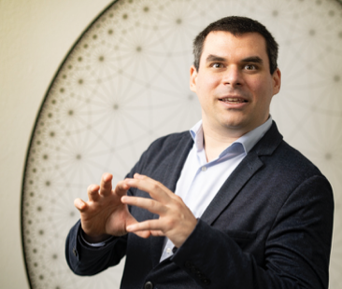




MASSIVIZING COMPUTER SYSTEMS – THE ICT INFRASTRUCTURE MEMEX
VU ON THE DIGITAL COMPUTING CONTINUUM
http://atlarge.science
Continuum = infrastructure for the 21st century, different from what we had before
This project has received funding from the European Union’s Horizon Research and Innovation Actions under Grant Agreement № 101093202.
@AIosup
Contributions from the MCS/AtLarge teams. Many thanks!
Prof.dr.ir. Alexandru IOSUP
Many thanks to our collaborators, international working groups, authors of all images included here. Also thanks to Radu Prodan, Martina Steinbacher, Dragi, Reza, and the KLU team.

Slide 2

US IN 3 MINUTES WE’RE MASSIVIZING COMPUTER SYSTEMS!
>
<

Slide 3

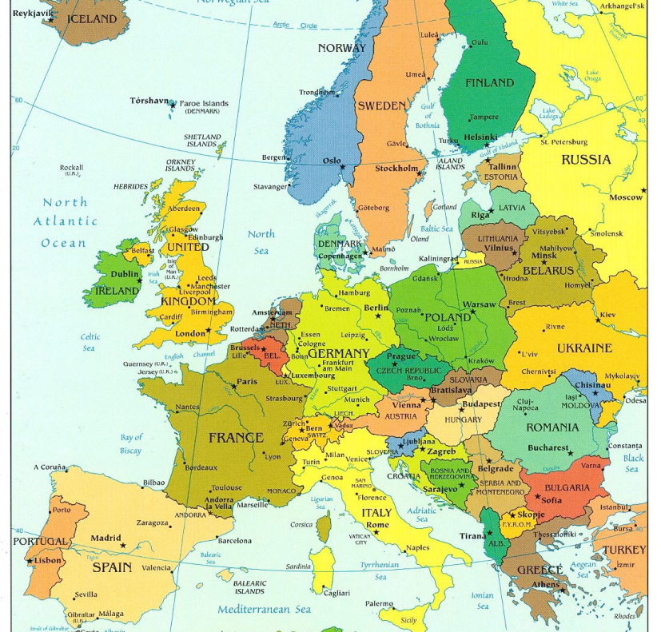
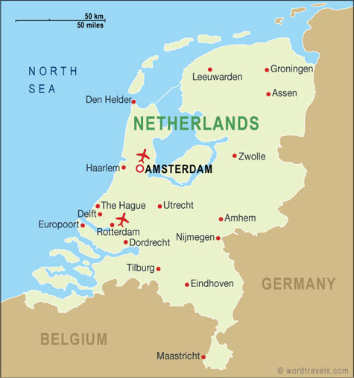
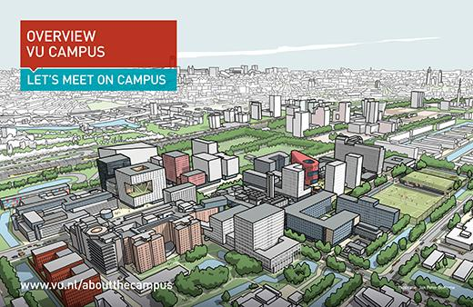

VU AMSTERDAM < SCHIPHOL < THE NETHERLANDS < EUROPE
Amsterdam
The Netherlands
Europe
founded 10th century
pop: 850,000
VU
founded 1880
pop: >25,000 (~ 5,000 staff)
pop: 16.5 M

Slide 4
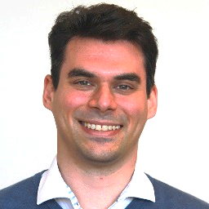
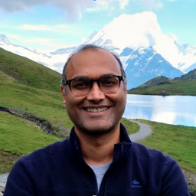
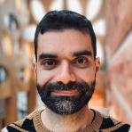
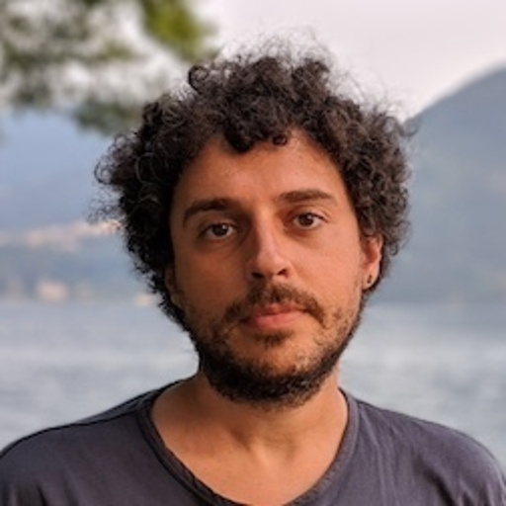
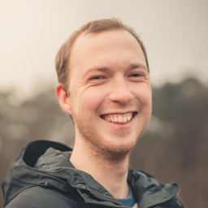
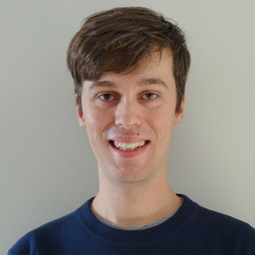
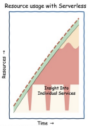

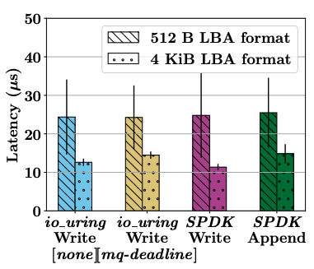
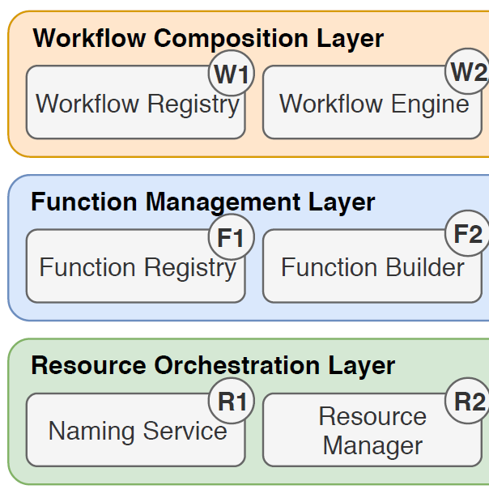



Research Group Bio
Massivizing Computer Systems
Alexandru IOSUP
Animesh TRIVEDI
Tiziano DE MATTEIS
Daniele BONETTA
Jesse DONKERVLIET
Matthijs JANSEN
https://atlarge-research.com
Group Bio: CompSys | Massivizing Computer Systems group | National/EU projects, incl. NL Groeifondsprogramma 6G Future Network Services (€315M, 7 years), NL NWO OffSense, EU Horizon Graph-Massivizer (€5M), EU MCSA-RISE CLOUDSTARS
Serverless ± virtualized cloud environments: RM&S for workflow and serverless ops, back-end services, aggregate and disaggregate resources, compute and IO, VM/contrainerization and JIT compiling, performance, availability, energy. Understand and experiment / analyze / benchmark ecosystems, design new parts, improve existing parts, share FAIR tools + Memex-like data. Digital Twin: ICT infrastructure/datacenter simulation, Operational Data Analytics, DC cockpit, VR/XR ops.
Relevant prior work (selection of tools and activities):
Serverless history + vision
OpenDC simulator
K8s/Storage benchmark
Continuum + Reference Archi
Benchmark
Cloud Group chair
Contact: info@atlarge-research.com

Slide 5
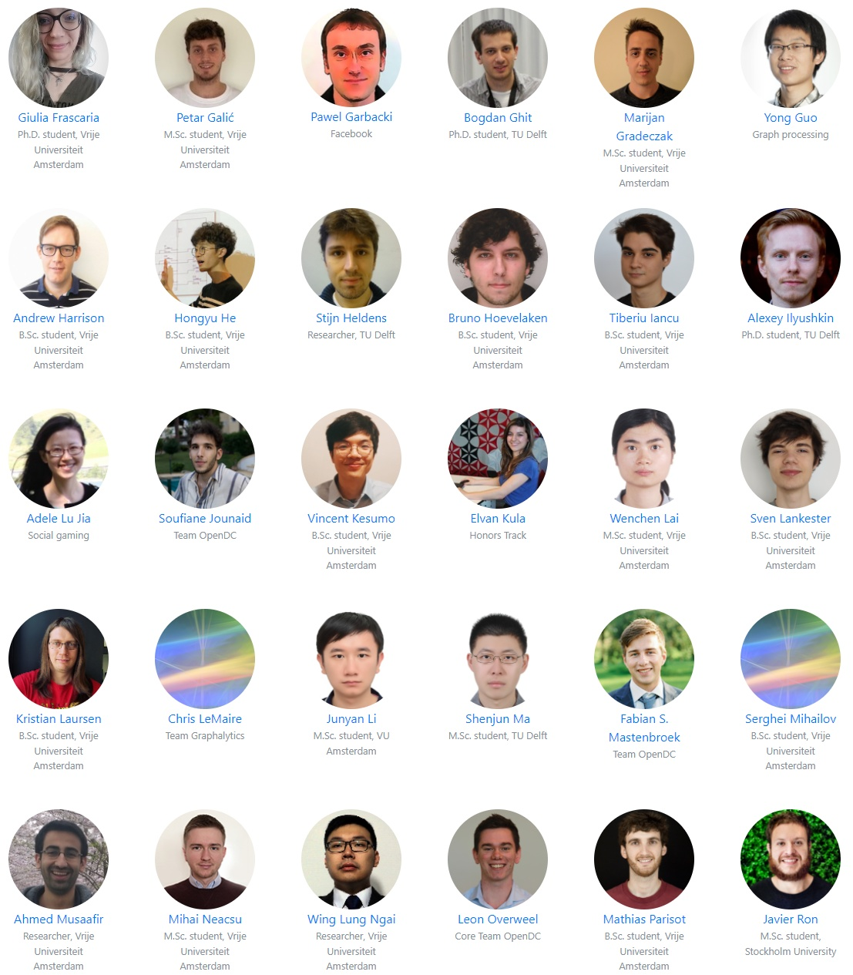

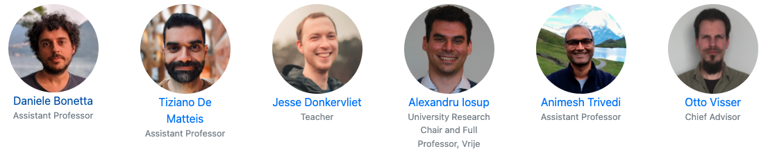
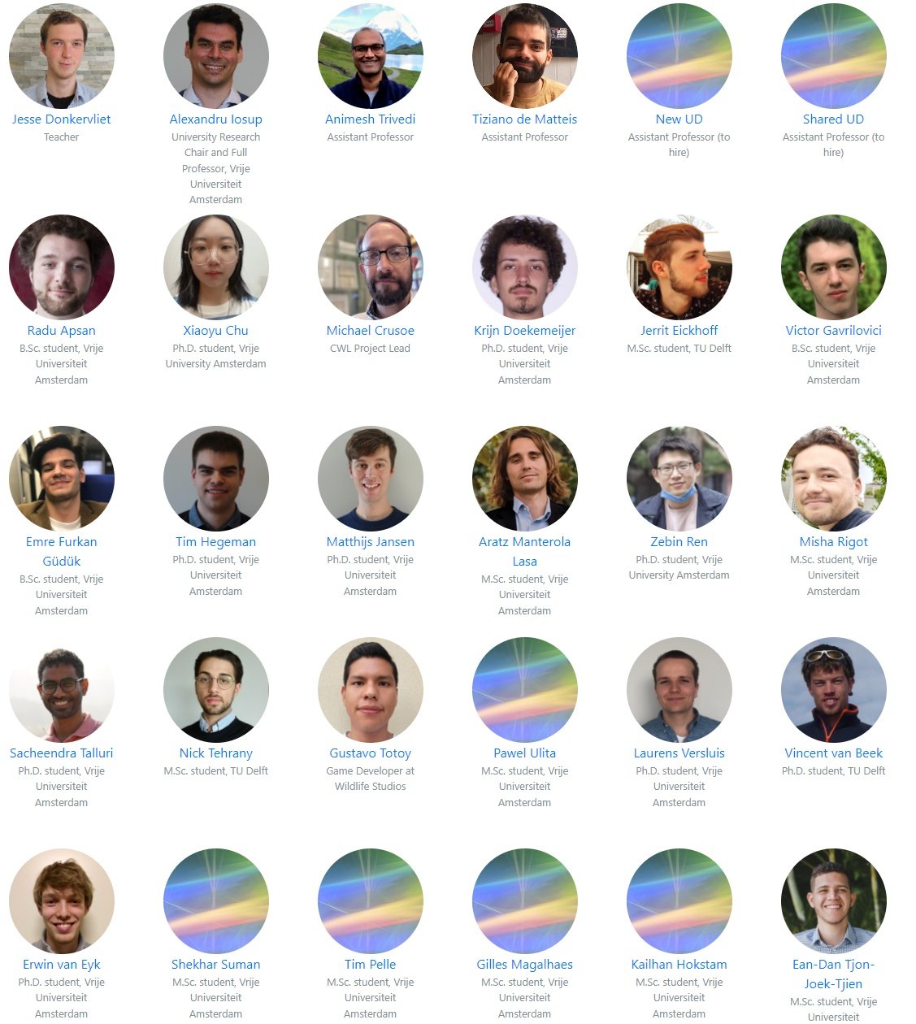
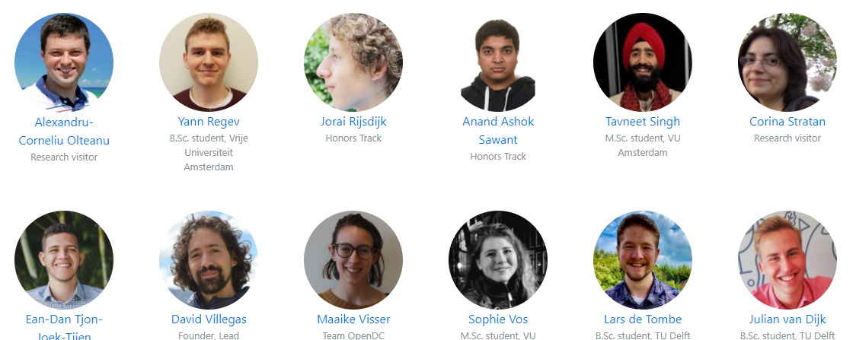
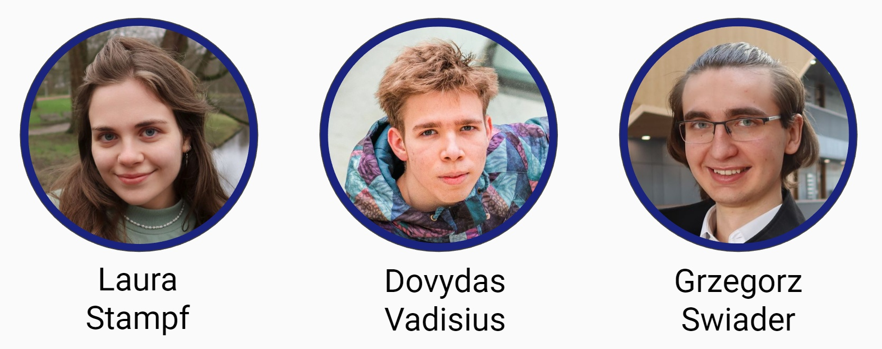

http://atlarge.science
Professor
ALUMNI
Assistant Prof.
Teacher
CURRENT TEAM
Visitor/P.-doc
Ph.D. student
VISITORS
Early Scientist MSc, BSc HP
WE ARE A FRIENDLY, DIVERSE, LARGE GROUP, OF DIFFERENT RACES AND ETHNICITIES, GENDERS AND SEXUAL ORIENTATION, AND VIEWS OF CULTURE, POLITICS, AND RELIGION. YOU ARE WELCOME TO JOIN!

Slide 6
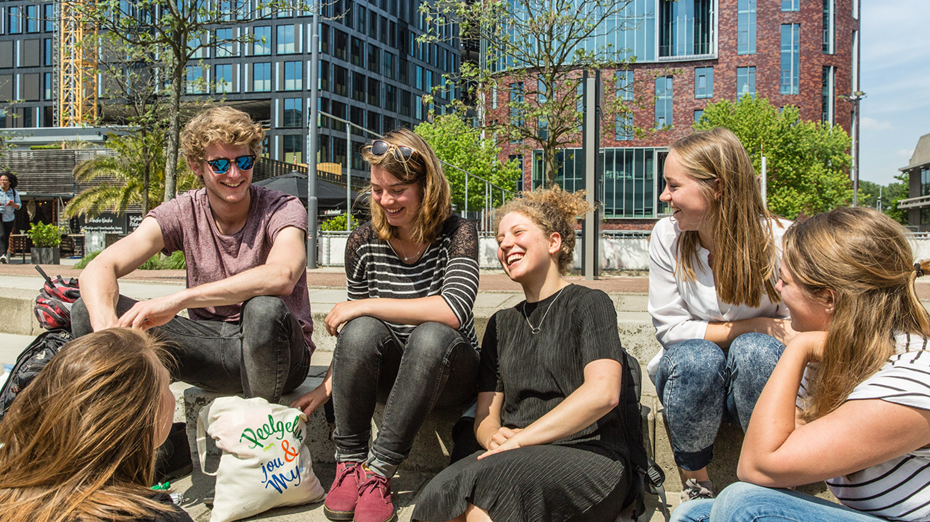
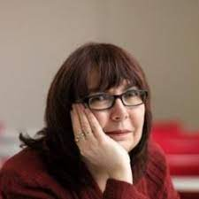
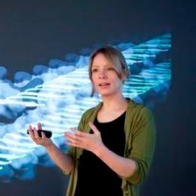
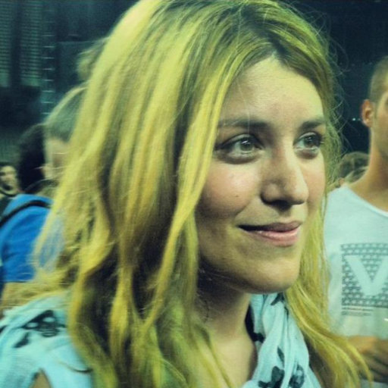
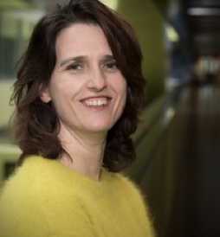
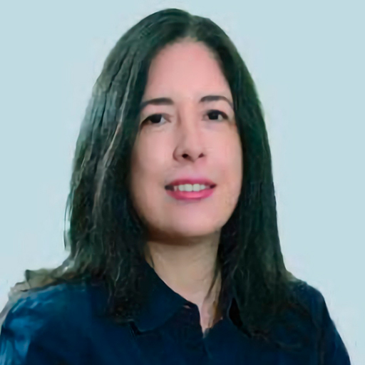
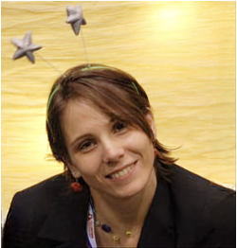
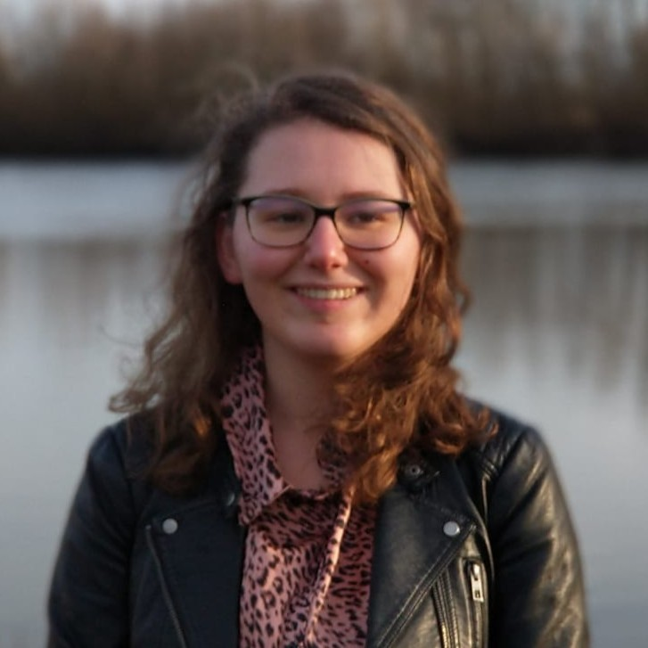
Challenges and Opportunities
DIVERSITY: CHALLENGES AND OPPORTUNITIES
Team and collaborators last year (biased selection)
Prof.dr. Carole Goble
Prof.dr. Sanne Abeln
dr. Chrysa Papagianni
dr. Paola Grosso
Prof.dr. Cristina Abad
Prof.dr.ir. Ana Lucia Varbanescu
Renske de Wit, MSc

Slide 7
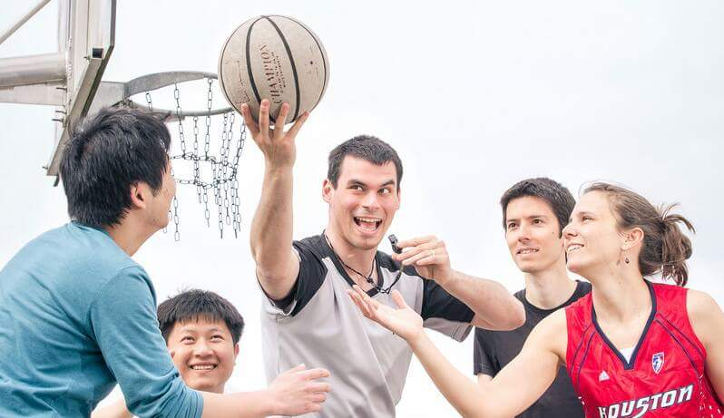
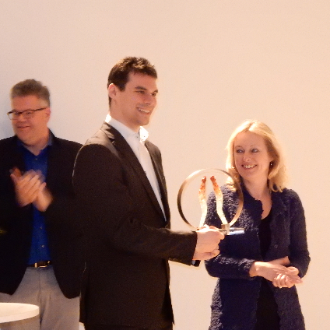

WHO AM I?
PROF. DR. IR. ALEXANDRU IOSUP
Education, my courses:
Honours Programme, Computer Org. (BSc)
Distributed Systems, Cloud Computing (MSc)
Research, 15 years in DistribSys:
Massivizing Computer Systems
About 30 young researchers in the team
About me:
Worked in 7 countries, NL since 2004
I like to help… I train people in need
VU University Research Chair + Group Chair
NL ICT Researcher of the Year
NL Higher-Education Teacher of the Year
NL Young Royal Academy of Arts & Sciences
Knighted in 2020

Slide 8
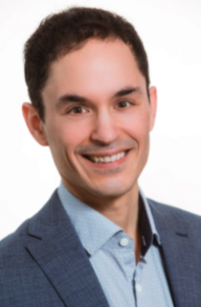


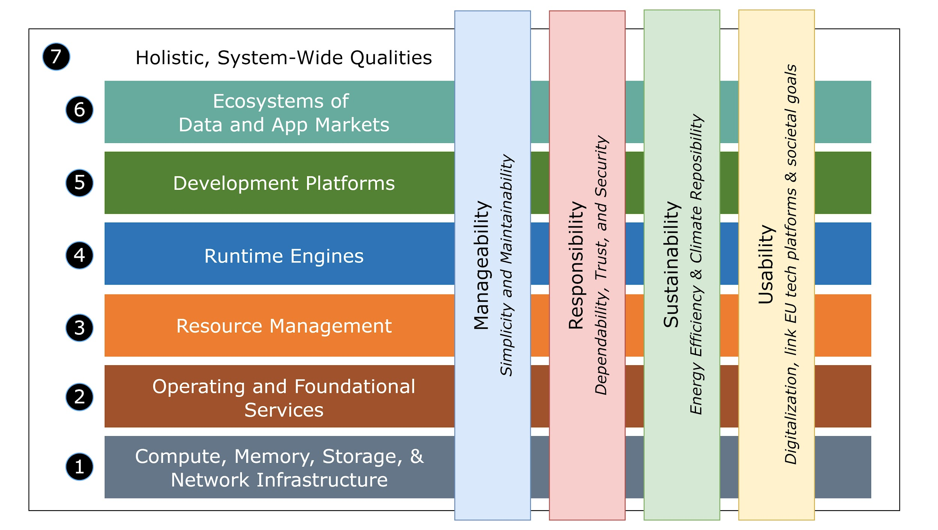
SIG FCSN + Manifesto on Computer Systems and Networking Research
SINCE LAST YEAR – RE-BOOTED THE COMPSYS NL COMMUNITY…
Clear vision for the field in the NL, 2021-2035
Signed
50 PIs / Leads
07 universities
05 relevant societal stakeholders
Available Full version https://arxiv.org/pdf/2206.03259
Who’s Who in CompSysNL? https://bit.ly/CompSysNLWhosWho

Slide 9
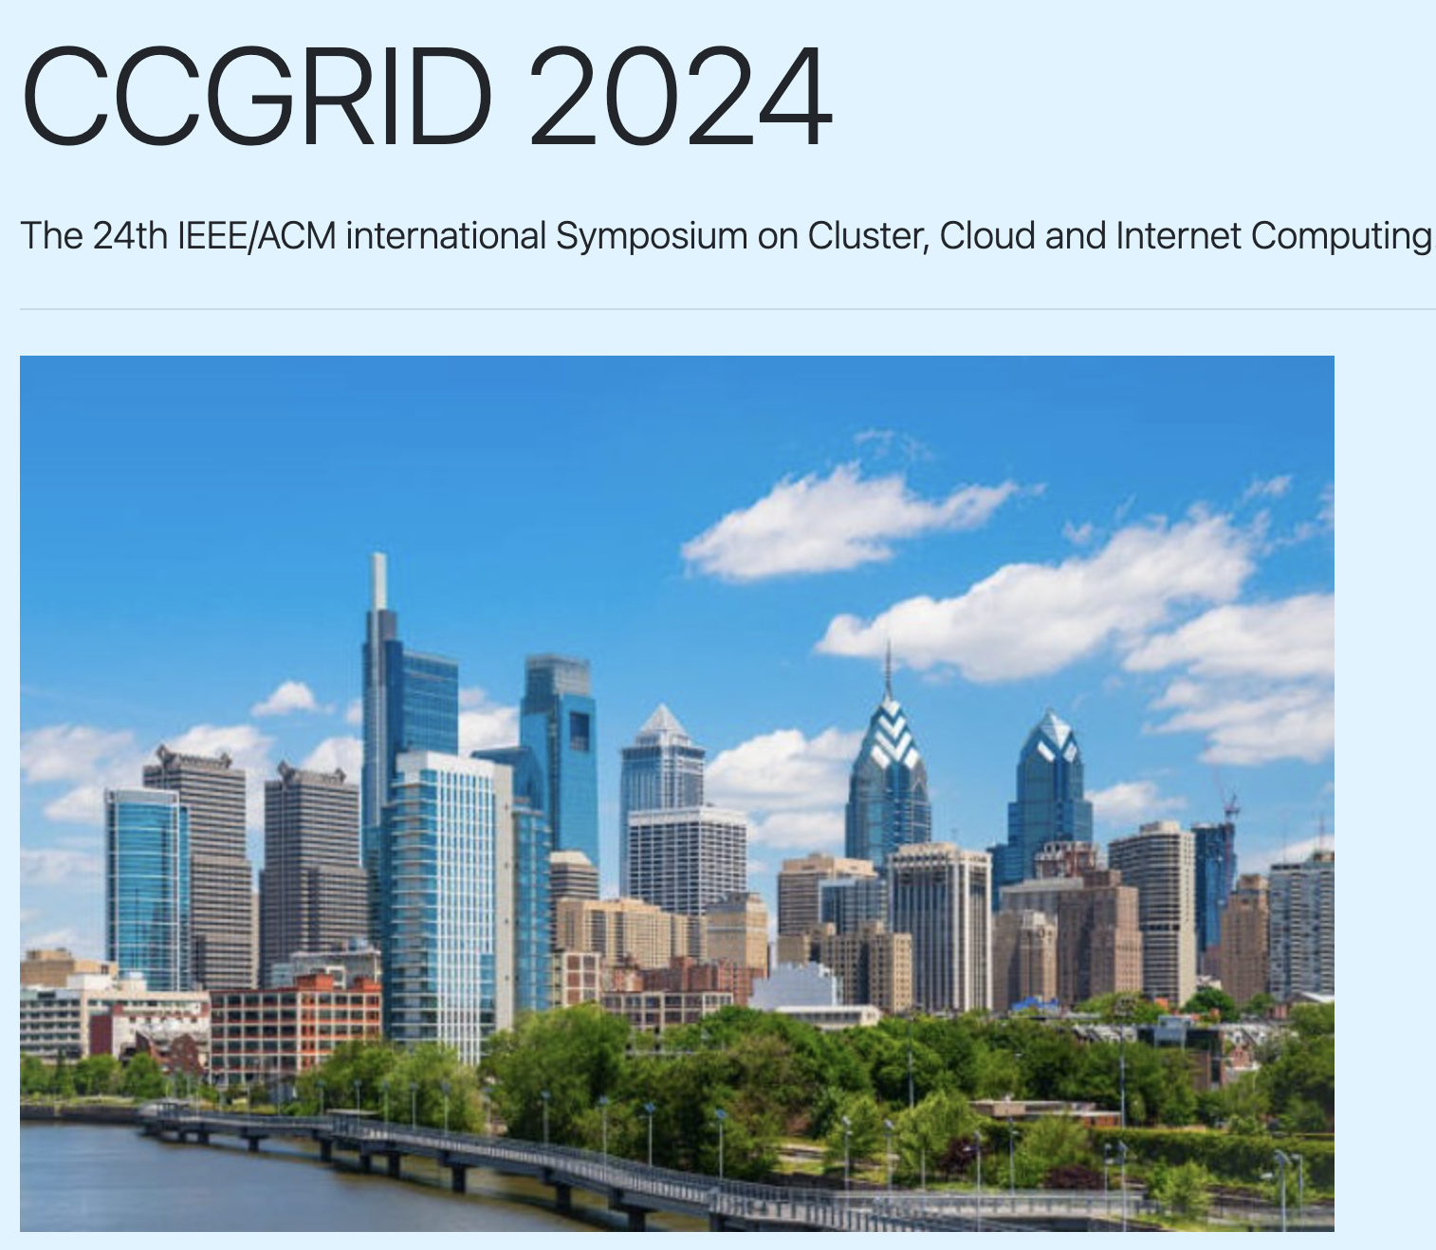
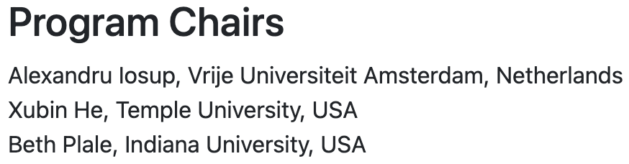
ONE CONFERENCE TO MENTION…
https://2024.ccgrid-conference.org/
Philadelphia, USA May 5-9, 2024
Hardware Systems and Networking
Software Systems and Platforms
Machine Learning (ML) for Systems and Systems for ML
Future Compute Continuum and Seamless Ecosystems
Applications and Workflows
Performance Monitoring, Modeling, Analysis, and Benchmarking
Distributed and Parallel Storage Systems
Education about Cluster, Cloud and Internet Computing
Notes:
Track 1: Hardware Systems and Networking: Sustainable and green computing; architecture, networking of data centers; virtualized hardware (GPUs, tensor processing units, FPGAs); RISC V / Open hardware architectures, etc.
Track 2: Software Systems and Platforms: Service-oriented architectures; utility computing models; IaaS, PaaS, SaaS; programming models and runtime systems; resource management and scheduling; and energy-efficient software.
Track 3: Machine Learning (ML) for Systems and Systems for ML: Techniques, platforms, and systems for supporting machine learning and artificial intelligence applications; use of ML/AI applications to enhance the performance of cluster, cloud and Internet-computing systems; ML/AI techniques for workload prediction; application scheduling, resource placement, resilience in cluster, cloud and Internet-computing systems.
Track 4: Future Compute Continuum and Seamless Ecosystems: Internet computing frontiers; future Internet; osmotic computing; cloud-economics; post- and Non-Von Neumann computing; quantum computing.
Track 5: Applications and Workflows: Data science; machine learning and artificial intelligence applications; cyber-physical systems; e-Health; Internet of Things (IoT)-enabled smart systems and applications; workflows.
Track 6: Performance Monitoring, Modeling, Analysis, and Benchmarking: Performance models; monitoring and evaluation tools; analysis of system/application performance; performance benchmarking; visualization for system or application performance; cloud performance; edge performance; and cloud-native performance tools.
Track 7: Distributed and Parallel Storage Systems: storage and memory stack architecture; distributed and parallel storage; HW/SW co-design for storage systems; NVM storage; cloud storage; edge storage; storage- and memory-as-a-service; file and data management; key-value stores; CDNs; data privacy, integrity, and regulation; resilience of service attacks.
Track 8: Education about Cluster, Cloud and Internet Computing: curriculum, didactics, and technology developments for cluster, cloud, and Internet-scale computing; virtual laboratory; teaching parallel and distributed systems; teaching performance; teaching cloud, cluster, and Internet-scale technologies; sharing digital learning objects; sharing lab experiments; reproducing educational experiments; teaching methodology in cluster, cloud and Internet computing.

Slide 10
THIS IS THE GOLDEN AGE OF COMPUTER ECOSYSTEMS
1
Notes:
Our society has turned digital: From science to business, from online shopping to online gaming, from education to government, digital applications depend every moment on Information and Communication Technology (ICT) infrastructure. To pilot this infrastructure and navigate through it, we need detailed information and decision-making support, provided on-time, cheaply, and reliably. (We briefly argue non-data-driven approaches are currently unable to cope with real conditions.)

Slide 11











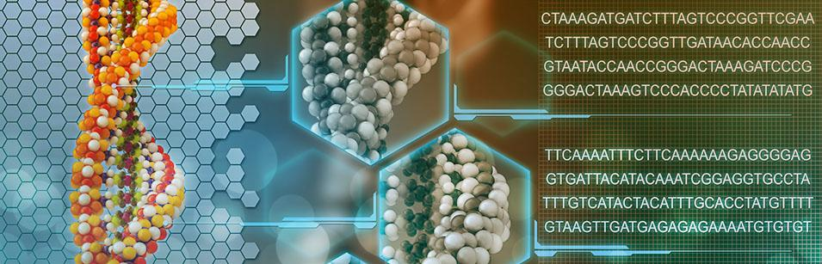



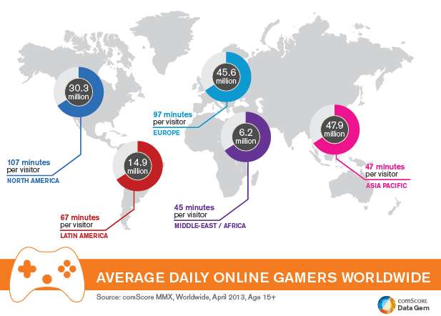




GENERALITY OF MASSIVE COMPUTER ECOSYSTEMS
+ AI e.g., ML/RL
Edge / IoT / Fog / … Computing
Business Services
Big Data
Education for Everyone (Online)
Internet
Computing Continuum
5G/6G/*
Cloud Computing
THz
VLC
Big Science
Online Gaming
+ Data e.g., as graphs
HPC / Grid Computing
Datacenter
Iosup et al. (2018) Massivizing Computer Systems, ICDCS. [Online] Hesselman, Grosso, Kuipers, et al. (2020) A Responsible Internet to increase Trust in the Digital World. JNSM [Online]
Daily Life

Slide 12
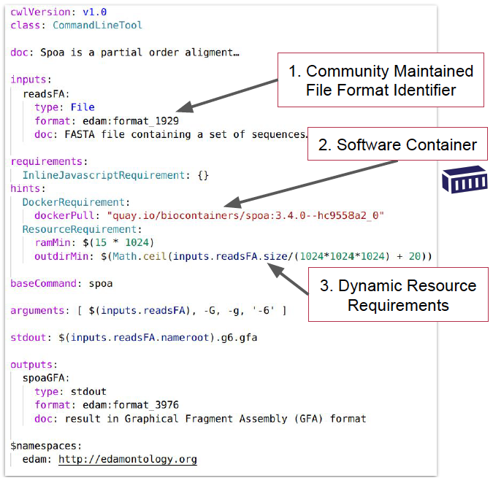
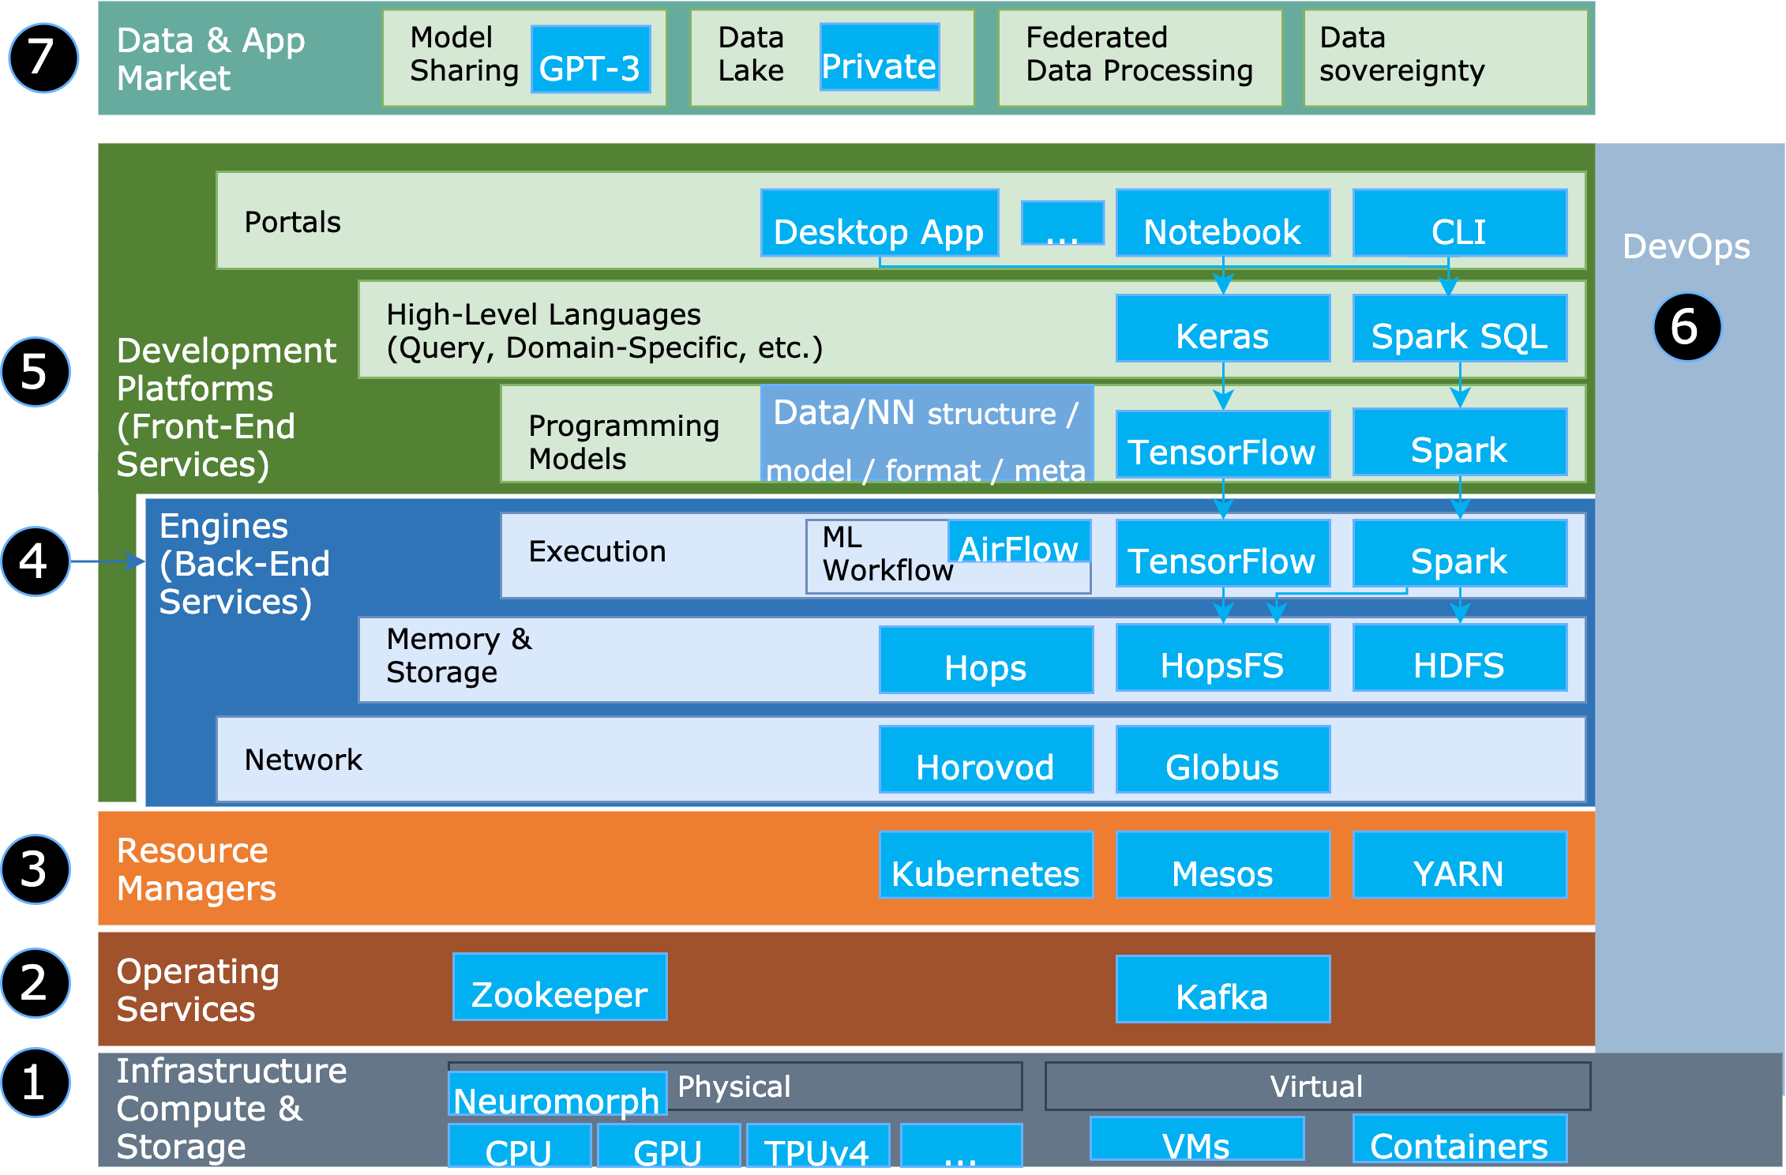
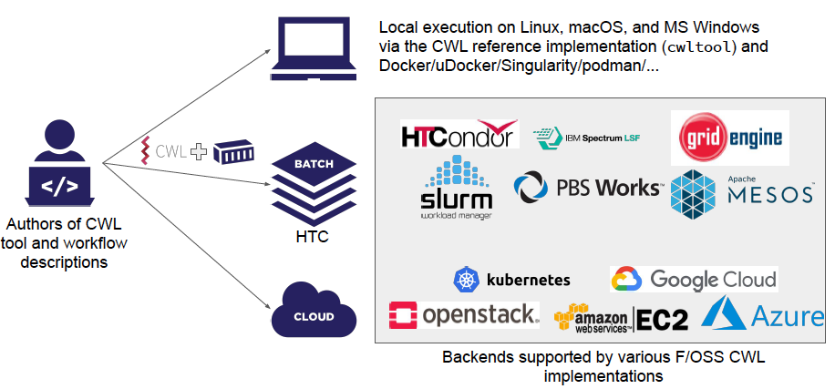
USING REPRODUCIBLE, COMPLEX WORKFLOWS …
^
Open
Public/
ISSUES: COMPLEXITY, NON-TECHNICAL
X
Actual ML app is a very small part!
Rest is systems, HW+SW, including HPC
SLURM
Crusoe et al. (2022) Methods Included: Standardizing Computational Reuse and Portability with the Common Workflow Language. CACM.
X

Slide 13
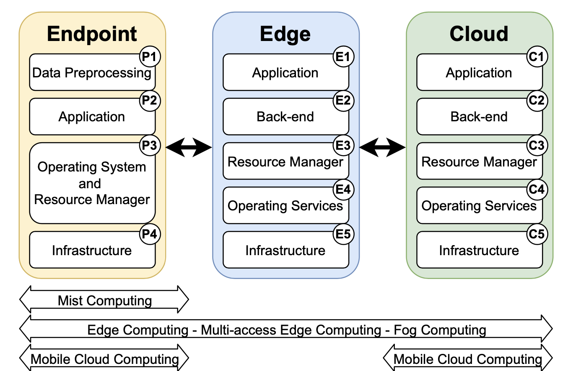
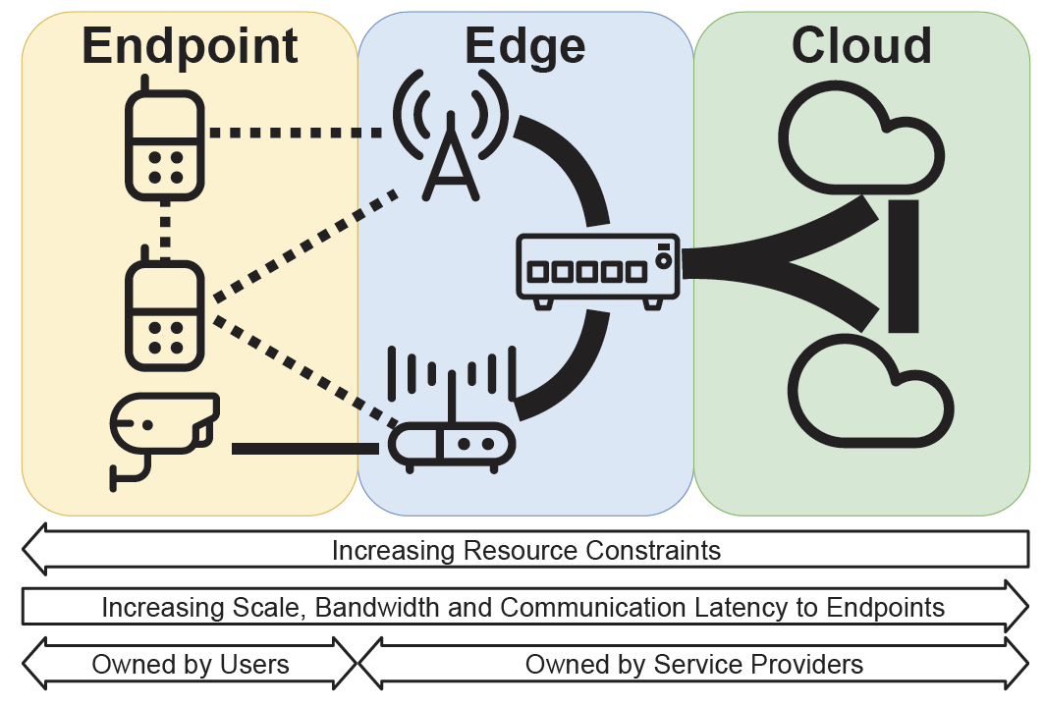
… RUNNING ON CONTINUUM RESOURCES & SERVICES
^
Public/
ISSUES: COMPLEXITY, NON-TECHNICAL
Trivedi, Wang, Bal, Iosup (2021) Sharing and Caring of Data at the Edge. HotEdge.
Jansen, Al-Dulaimy, Papadopoulos, Trivedi, Iosup (2023) The SPEC-RG Reference Architecture for the Edge Continuum. CCGRID. Open access: https://doi.org/10.48550/ARXIV.2207.04159

Slide 14





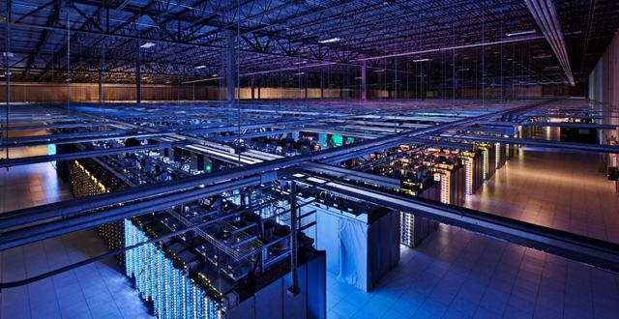



… IN A SMARTLY ORCHESTRATED ICT ECOSYSTEM …
^
Workload
100s of services … an ecosystem
Time
Creators
Digital Services
Resource Manager and Scheduler
Computing Continuum
RM&S
Source: Google
Extreme Automation, Performance, Dependability, Sustainability

Slide 15
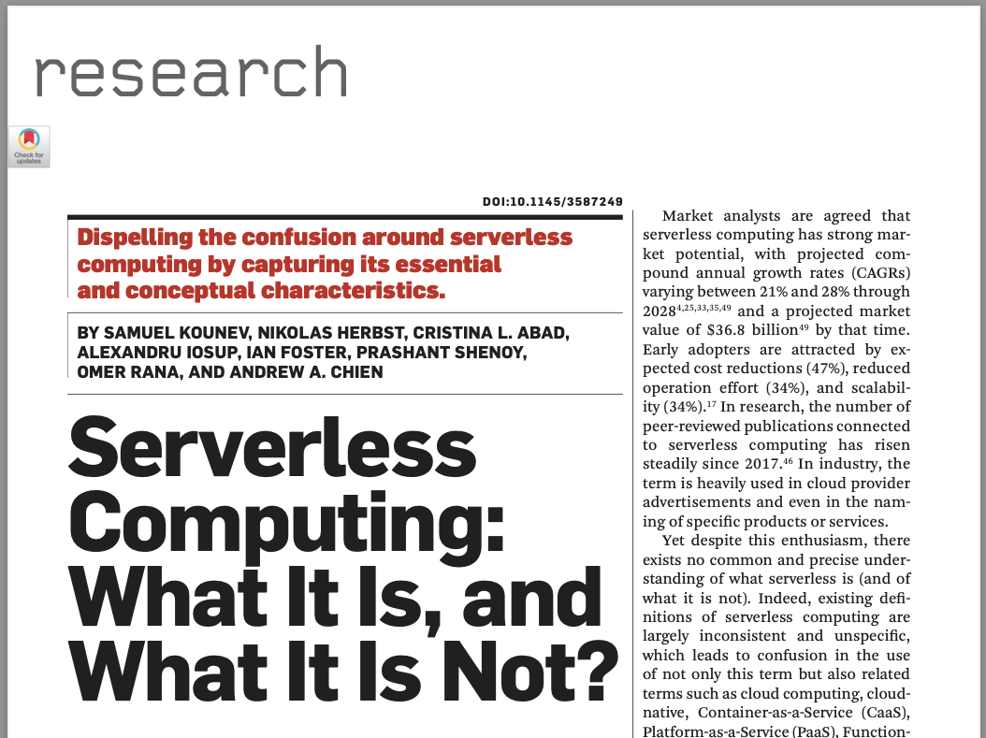
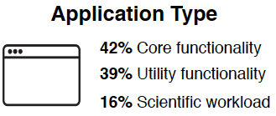
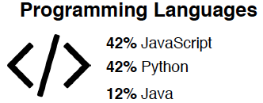
…DELIVERING SERVERLESS COMPUTING PROPERTIES
^
bit.ly/MassivizingServerless22
Public/
Serverless computing = extreme automation + fine-grained, utilization-based billing
Simon Eismann, Joel Scheuner, Erwin Van Eyk, Maximilian Schwinger, Johannes Grohmann, Nikolas Herbst, Cristina L. Abad, Alexandru Iosup (2022) The State of Serverless Applications: Collection, Characterization, and Community Consensus. IEEE Trans. Software Eng. 48(10)
Kounev, Herbst, Abad, Iosup, Foster, Shenoy, Rana, Chien (2023) Serverless Computing: What It Is, and What It Is Not? CACM. Sep 2023 issue.

Slide 16
BUT WE CANNOT TAKE THIS TECHNOLOGY FOR GRANTED (We need science to tackle the issues)
2
Notes:
Our society has turned digital: From science to business, from online shopping to online gaming, from education to government, digital applications depend every moment on Information and Communication Technology (ICT) infrastructure. To pilot this infrastructure and navigate through it, we need detailed information and decision-making support, provided on-time, cheaply, and reliably. (We briefly argue non-data-driven approaches are currently unable to cope with real conditions.)

Slide 17
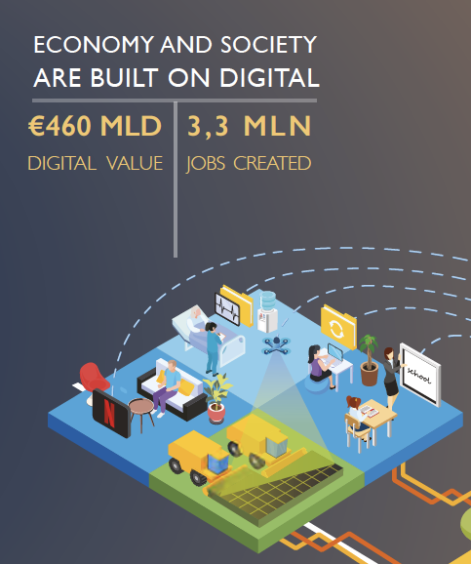

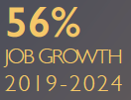
RESPONSIBILITY OF MASSIVE COMPUTER ECOSYSTEMS
Power consumption of datacenters:
>1% → >3% of global electricity
Source: Nature, 2018 [Online] NRC, 2019 [Online]
&
Water consumption of datacenters in the US:
>625Bn. l/y (0,1%)
Impacts >60% of the NL GDP (1 trillion EUR/y)
Source: Energy Technologies Area, 2016 [Online]
A Jevons paradox of computer ecosystems?
Other climate impact:
Largely unreported
Source: NASA Earth Observatory
Sources: Iosup et al., Massivizing Computer Systems, ICDCS 2018 [Online] / Dutch Data Center Association, 2020 [Online] / Growth: NL Gov’t, Flexera, Binx 2020. Gartner 2019. IA 2017.

Slide 18
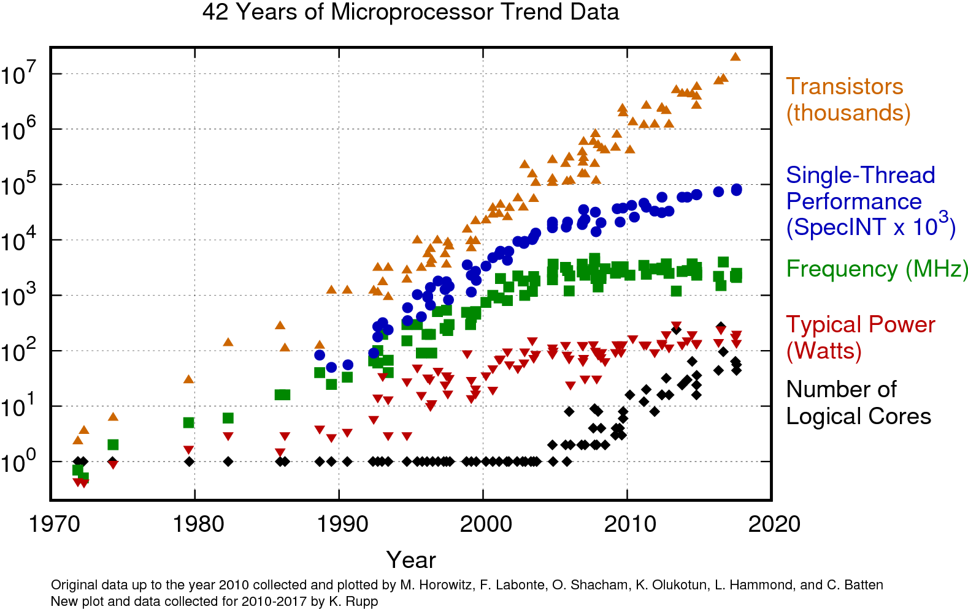
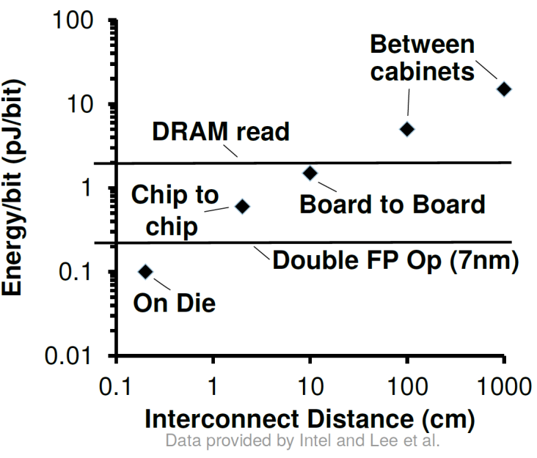
TECHNOLOGY EVOLUTION
END OF MOORE’S LAW/DENNARD SCALING → COMPLEX, DISTRIBUTED ECOSYSTEMS
Need for parallelism and distribution
End of Dennard Scaling “Performance for free” ends Moore’s Law “doubling” slows down
Cost of energy for data movement still high
Source: karlrupp.net

Slide 19
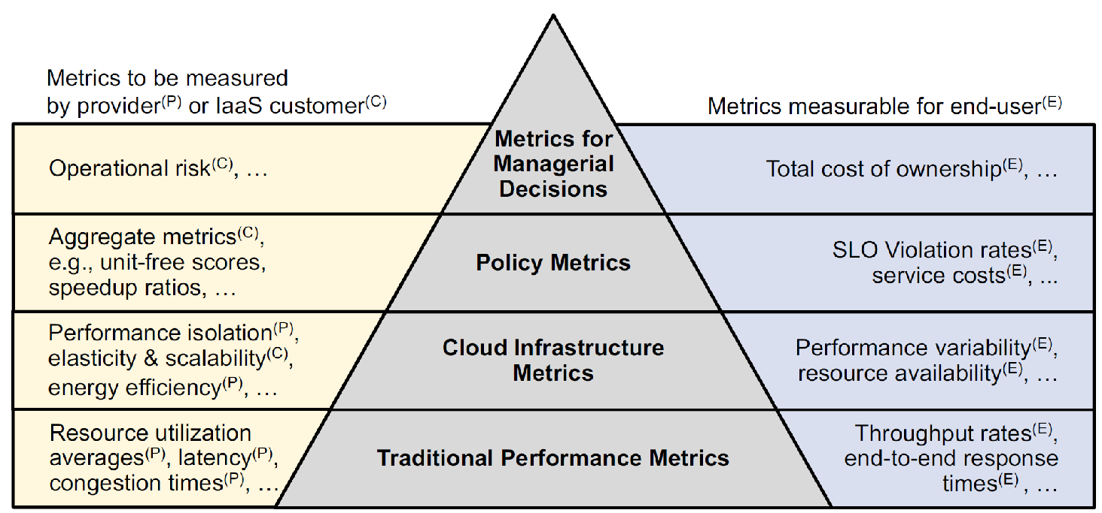
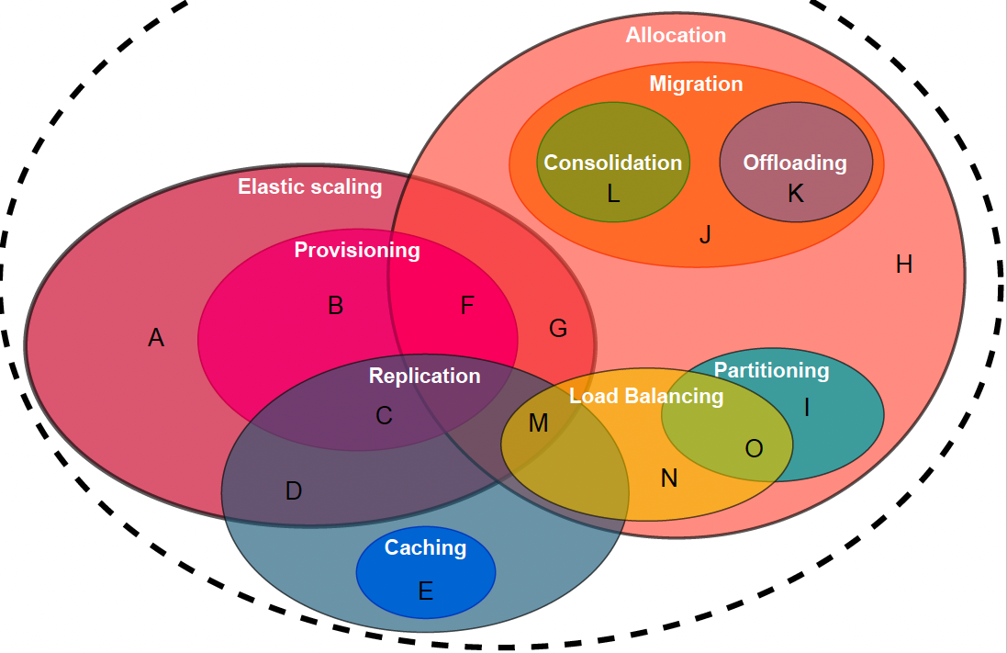
Complexity Challenge
COMPLEXITY GROWS
COMPLEX, DISTRIBUTED ECOSYSTEMS DO NOT ACT LIKE REGULAR COMPUTER SYSTEMS
Ecosystems don’t have easily…
Operational goals are becoming more complex
Operational techniques are becoming more complex
Simplicity
Maintainability
Responsibility
Sustainability
Usability
which includes:
Synchronization
Consistency, consensus
Performance
Scalability, elasticity
Availability, reliability
Energy-efficiency
Iosup, Kuipers, Trivedi, et al. (2022) Future Computer Systems and Networking Research in the
Netherlands: A Manifesto. CORR
N. Herbst, E. Van Eyk, A. Iosup, et al. (2018) Quantifying Cloud Performance and Dependability: Taxonomy, Metric Design, and Emerging Challenges. TOMPECS 3(4).
Stijn Meijerink, Erwin van Eyk, Alexandru Iosup (2021) Multivocal Survey of Operational Techniques for Serverless Computing. White Paper.

Slide 20

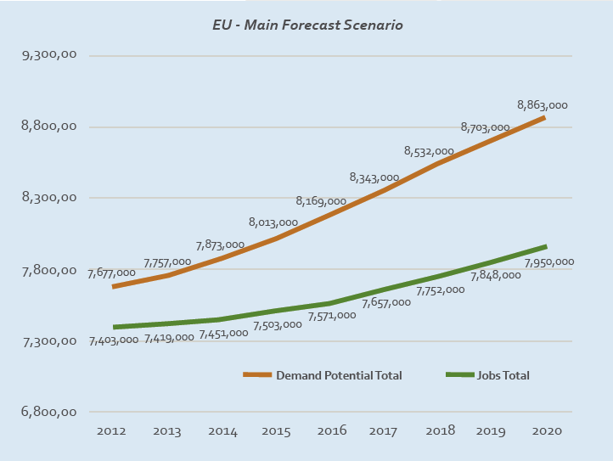
































FEW CAN OPERATE COMPLEX IT ECOSYSTEMS
THE WORKFORCE GAP, IN THE NETHERLANDS & IN EUROPE
EU: 910k
NL: 50k
EU: 780k
Does not start at 0!
Source: e-Skills for Jobs in Europe, 2014
Notes:
Last in this talk, we have a Systems Crisis because there are not enough systems people to solve the problems we can solve. The EU has commissioned in 2014 a study of its key workforce challenges. We have a large gap of skilled ICT professionals, and the gap grows yearly: we will miss over 900,000 in Europe (50,000 in the Netherlands) by 2020. This is a dire peopleware problem, which we cannot solve with the current approaches (that detach science from education.)

Slide 21


PHENOMENON: PERFORMANCE IN CLOUD SERVICES
UNCOVERING THE PRESENCE OF PERFORMANCE ISSUES, EVEN LEADING TO CRASHES
Source: http://bit.ly/EveOnline21Crash
Source: Razorien/CCP Games
Notes:
-- 05:00-05:15 (15”)
Also performance and scalability are difficult to manage. When we don’t do it well, cloud services crash. Worse, there can be long-lasting effects, and recovering the ecosystem to correct state is much more difficult than we think.
Source: https://www.polygon.com/2021/1/5/22214982/eve-online-world-record-massacre-m2-xfe-ghost-titans

Slide 22




The Future Is Big Graphs
GRAPH DATA EVERYWHERE, UNPRECEDENTED SCALE
NEED TO MASSIVIZE GRAPH PROCESSING
Social / gaming network
~1 billion vertices ~100 billion connections
Brain network
~100 billion neurons ~100 trillion connections
Web graph
~50 billion pages ~1 trillion hyperlinks
Sources: Smith, CHI’10; Blog webpage; Gigandet et al., PLoS ONE 3(12)]
Sakr, Bonifati, Voigt, Iosup, et al. (2021) The Future Is Big Graphs! CACM.
Notes:
Consider the case of graph processing. Graphs are a natural fit for modeling concepts used in solving diverse problems from various scientific and engineering domains, and also in governance and industry. As a result, graph processing is pervasive. Many graphs can be large-scale, and graph applications require significant data and computation.

Slide 23



Notes:
An example of another graph challenge: visualisation. This is based on force-directed graph drawing algorithms, which are iterative and have complexities between O(n logn) and O(n^3).

Slide 24

PHENOMENON: PERFORMANCE IN CLOUD SERVICES
UNCOVERING THE PRESENCE OF PERFORMANCE ISSUES, EVEN LEADING TO CRASHES
Feature discontinued!

Slide 25
IN THIS TALK: INTRO TO THE DIGITAL / COMPUTING / EDGE-CLOUD CONTINUUM (What do we need in CompSys infrastructure for the 21st century)
3

Slide 26


Big Graph Processing: Used in AI/ML, FinTech, ICT Infra., Industry 4.0, Energy Mgmt.*, etc.
ONE PROJECT TO MENTION…
Vision: Massivizing computer systems approaches are key to enable big graph ecosystems
Graph-Massivizer
EU Horizon project (starting 2023)
CACM Cover/Featured article, Sep 2021
(*) Digital twin for datacenters, with partners CINECA, UniBo, etc.
Sakr, Bonifati, Voigt, Iosup, et al. (2021) The Future Is Big Graphs! CACM.
Notes:
ACK: Radu Prodan (KLU)

Slide 27



Trustworthiness
Digital autonomy
Sustainable
Earning power
2024—2030 € 315 M 75+ partners
Notes:
We have an ambition in NL to drive specific parts of the 6G R&D activities in Europe.
This presentation will give you high-level insights in the plan, the program & the Scope.
We want to share our ambition and are open to international partnerships

Slide 28
Objectives AND kEY TECHNOLOGIES FOR A 6g DevOps PLATFORM & DIGITAL TWIN
Phase 1: 2024–mid-2026
Reduce complexity for app providers and network operators through a comprehensive DevOps platform, including a 6G Digital Twin.
T2.2.1 6G-ready app development
T2.2.2 Declarative app deployment and operation
T2.2.3 App testing and life-cycle management
T2.2.4 Models & simulation for a 6G Digital Twin
T2.2.5 Intent-based networking & explainability
T2.2.6 Resilient & secure network evolution
Toolchains for app providers
D2.2.2 6G DevOps Platform
Demonstrator
Developing front- and back-end services for event-driven serverless and data-streaming workflow apps
Developing software components and pipelines for declarative app deployment and operation
Defining, benchmarking, and facilitating apps, and providing concrete evidence of operational performance
Toolchains for network operators
D2.2.1 6G Digital Twin
Demonstrator
Digital twinning of full-stack 6G networks, linked to telemetry from WP2.3
Leveraging Intent-Based Networking to instruct and interact with AI-driven network
Managing and evolving resources to respond to long-term needs, recover from disasters, etc.

Slide 29


6G-ready app development (T2.2.1)
Disclaimer: Examples only for illustrative purpose.
[suggested lead]
[TU/e, ISRD, Keysight, TNO, TU Delft, SURF, VU]
Objective: Develop front&back-end services, tools, and an app store for 6G-ready apps – workflow-based & serverless
Approaches:
Adopt global pre-standards for open, disaggregated resources and services
Facilitate front- and back-end services
Support zero-code development
Outputs:
Back-end services for individual users and apps: 6G-network, memory and I/O, and compute engines
Front-end services for programming 6G-ready apps with event-driven serverless and data-streaming workflow-based structure
Tools and app store to share apps and data
D2.2.2 (M48, M78): 6G DevOps Platform. Software (incl. algorithms) + website + demonstrator
MS2.2.3/.10 (M24/M60) + MS2.2.6/.11 (M30/M72) + MS2.2.7(M48): 1st/2nd SW release of the 6G DevOps platform + Stakeholder (beta) testing + Demonstrator
[Crusoe et al. (2022) Methods included. Commun. ACM.]
Serverless computing = Extreme automation + fine- grained, utilization-based billing
[Eismann et al. (2022) The State of
Serverless Applications. IEEE TSE.]
Notes:
Output:
● Back-end services, corresponding to 6G-network, memory and I/O, and compute
engines that aim to provide core services for individual users and/or apps. This
includes common (6G) functions needed for operation + points of entry (APIs) for (less
common) 6G functions.
● Front-end services for programming 6G-ready apps with event-driven serverless
and data-streaming workflow-based structure, e.g., notebooks with 6G data
streams, and zero-code app development through portals and composition from
shared data/code.
● Tools for 6G-ready app development.
● A trusted “app store” through which applications and data can be shared.

Slide 30


Declarative app deployment and operation (T2.2.2)
Disclaimer: Examples only for illustrative purpose.
[Solvinity, ISRD, SURF, TNO, VU]
Objective: Develop software components and pipelines to reduce complexity through declarative app deployment and operation (ADO)
Approaches:
Understand diversity of services, devices, and app requirements, incl. dependability, security, trust, and fast communication and control paths
Take declarative approach to ADO
Orchestrate Service-to-Service and App-to-App networking, through mesh services
Outputs:
Software components for declarative deployment & operation of 6G apps across the digital continuum
Front-end for event-driven serverless and data-streaming workflow apps
Back-end services, incl. meshes, security w/ ACL, etc.
D2.2.2 (M48, M78): 6G DevOps Platform. Software (incl. algorithms) + website + demonstrator
MS2.2.10 (M60) + MS2.2.11 (M72): 2nd SW release of the 6G DevOps platform + Stakeholder (beta) testing
Declarative Deployment
[Jansen et al. (2023) Continuum: Automate Infrastructure Deployment and Benchmarking in the Compute Continuum. FastContinuum.]
Digital Continuum
[Jansen et al. (2023) The SPEC-RG Reference Architecture for the Compute Continuum. CCGRID.]
Notes:
Output:
● Software components for declarative deployment and operation of the digital
continuum, both standard interfaces (baseline) and extensions across the 6G
networks and heterogeneous devices.
● Software components for declarative deployment and operation of back-end
services, including service meshes to integrate different services, security services
based on access control, etc.
● Software components for declarative deployment and operation of front-end
services for 6G-ready apps with event-driven serverless and data-streaming
workflow-based structure.
● Declarative deployment and operation pipelines, including deployment for
A/B-testing and other fine-tuning experiments for 6G.

Slide 31

App testing and life-cycle management (T2.2.3)
Disclaimer: Examples only for illustrative purpose.
[SURF, Keysight, Solvinity, TNO, TU Delft, VU]
Objective: Define and develop software for benchmarking and acceptance testing for PL3 apps, and a website with concrete evidence of operational performance
Approaches:
Benchmarking and acceptance testing
Life-cycle management, incl. human-in-the-loop, evolving code & data
Focus on PL3 application domains and AI/ML
Focus on privacy, getting rid of unwanted data, etc.
Outputs:
Definition & software benchmarks and acceptance tests
Definition & software for life-cycle management
Website with concrete evidence of operational performance
D2.2.2 (M78): 6G DevOps Platform. Software (incl. algorithms) + website + demo
MS2.2.10 (M60) + MS2.2.11 (M72): 2nd SW release of the 6G DevOps platform + Stakeholder (beta) testing
ML app
The HW+SW stack of a modern datacenter
[Adapted from: Bonifati et al. (2020) The Future is Big Graphs! A Community View on Graph Processing Systems. CACM.]
Notes:
This task defines and creates (app-driven) benchmarks and acceptance tests, followed by concrete
evidence the DevOps platform passes these. There is a direct link to the software
life-cycle, e.g., testing and lifecycle management of app-driven network services, aspects
related to human-in-the-loop, evolving code and data (managing licenses, protecting and getting rid of data, etc.).
Output:
● Definition and software implementing benchmarks and acceptance tests for
application domains from program line 3 and cross-domain DevOps such as AI/ML,
and for software resources/services that support the DevOps active interfaces.
● A website with concrete evidence that the platform passes the acceptance tests
for event-driven serverless applications, and with benchmarking results about the
overall performance of the platform.
● Definitions and software implementing life-cycle management for 6G-ready
applications, e.g., monitoring and reporting on top of the deployment and
operation pipelines from T2.2.2.

Slide 32


Models & simulation for a 6G digital twin (T2.2.4)
Disclaimer: Examples only for illustrative purpose.
[VU, Almende, AMS-IX, ISRD, Keysight, KPN, Solvinity, SURF, TNO, TU Delft, UvA, VodafoneZiggo]
Objective: Develop a digital twin system for full-stack 6G networks, linked to telemetry and input from WP2.3
Approaches:
6G Digital Twin integrating a software simulator and/or emulator to predict network behavior
Live telemetry and input from WP2.3
Means to verify management and control actions before executing them in real environments
Outputs:
A digital twin system for full-stack 6G networks
Interfaces physical-twin 6G networks
Library of 10+ digital twin configurations
Report on 6G digital twinning: operational guidelines, lessons learned
D2.2.1 (M42/M72): 6G Digital Twin. Software (incl. algorithms) + GUI + Demonstrator
MS2.2.1 (M18): Architecture for 6G Digital Twin
MS2.2.2/.8 (M24/54) + MS2.2.4/.9 (M30/M60) + MS2.2.5 (M42): 1st/2nd SW release of the Digital Twin + Stakeholder (beta) testing + Demonstrator
Digital Services
Datacenter
Real-world Infrastructure
Workload
Time
[Mastenbroek et al. (2022) OpenDC 2.0. CCGRID.]
Simulated Infrastructure
Notes:
Output:
● A digital twin system for full-stack 6G networks, implementing the architecture and
process from T2.1.2, the telemetry and input from WP2.3. The digital twin will
support specific phenomena, e.g., generators for performance variability, and for
failures and other impairments.
● Interfaces between the physical 6G networks and the virtual (twin) 6G networks.
● Library of 10+ digital twin configurations, established as best-practices, shared as
FAIR metadata.
● Report on 6G digital twinning, establishing operational guidelines and
communicating lessons learned.

Slide 33
Intent-based networking & explainability (T2.2.5)
Disclaimer: Examples only for illustrative purpose.
[AMS-IX, ISRD, Keysight, SURF, TNO, TU Delft, UT, UvA]
Objective: Develop an intent-based networking (IBN) language and concepts to instruct and interact with
the AI-assisted network, and related explainability tools.
Approaches:
IBN language and concepts to instruct and interact with the AI-assisted network
Both operator-to-network and network-to-operator communication
Focus on network explainability: AI explains to operator
Outputs:
IBN language and concepts to instruct and interact with the AI-assisted network
Tool to explain, in IBN language, what is happening in the network
Network explainability tool, linked to 6G Digital Twin (T2.2.4)
D2.2.1 (M42/M72): 6G Digital Twin. Software (incl. algorithms) + GUI + Demonstrator
MS2.2.1 (M18): Architecture for 6G Digital Twin
MS2.2.8 (54) + MS2.2.9 (M60): 2nd SW release of the Digital Twin + Stakeholder (beta) testing + Demonstrator
[Crusoe et al. (2022) Methods included. Commun. ACM.]
Notes:
An IBN language is a high-level language that is easier to understand and work with than
the low-level configuration languages of current network devices.
Output:
● An intent-based networking (IBN) language and concepts (including
human-in-the-loop process, based on digital twinning) to instruct and interact with
the AI-assisted network.
● A tool that can explain, in IBN language, what is happening in the network.
● A network explainability tool to speed up root-cause analysis, by (causally) linking
telemetry information to configuration and software elements and within a single
or across multiple operational layers.

Slide 34


Resilient & secure network evolution (T2.2.6)
Disclaimer: Examples only for illustrative purpose.
[Almende, AMS-IX, ISRD, Keysight, TNO, TU Delft, TU/e, UT, UvA]
Objective: Develop a methodology and tools for resilient/robust network planning and capacity management, and for preparing in advance disaster-recovery responses
Approaches:
Decision support system, partially based on AI
Focus on managing and evolving resources to respond to long-term needs, recover from disasters, etc.
Leverage also external data, e.g., extreme weather forecasts, large-scale disaster and/or attack scenarios, etc.
Outputs:
Methodology, incl. data-driven mechanism for risk analysis
Tool for resilient/robust network planning and capacity mgmt.
D2.2.1 (M42/M72): 6G Digital Twin. Software (incl. algorithms) + GUI + Demonstrator
MS2.2.1 (M18): Architecture for 6G Digital Twin
MS2.2.8 (54) + MS2.2.9 (M60): 2nd SW release of the Digital Twin + Stakeholder (beta) testing + Demonstrator
[Mastenbroek, De Matteis, Iosup (2022)]
Electricity expenses are now primary risk in datacenters

Slide 35

Message:
A new way of thinking about continuum systems
4

Slide 36
Traditional system models in computing
System and the systems view
Computer network
Operating system
Computer system (from CO course)
OS
OS
OS
Notes:
Meadows: system is “a set of elements or parts coherently organized and interconnected
in a pattern or structure that produces a characteristic set of behaviors, often classified as its
“function” or “purpose.”
Computer system: typically von Neumann model, program as instructions, instruction sequencing, complexity, scalability, performance, reliability
Operating system: software to allow developers to use the computer system. Concepts: process, virtualization of resources, concurrency, time-sharing and other RM&S.
Computer network: communicate (move) data between source and destination, possibly group entities. Concepts: data, control, management planes.

Slide 37

Computing continuum (over)view
How well do previous system models match this?
Slide by Ana-Lucia Varbanescu
https://futuresoftech.com/edge-computing-101/

Slide 38

Computing continuum (over)view
How well do previous system models match this?
Slide by Ana-Lucia Varbanescu
https://opennebula.io/blog/experiences/building-an-open-source-edge-computing-platform/

Slide 39
Distributed Systems
4.1

Slide 40
What is a Distributed System? Our definition
Group of 2+ constituents, often homogeneous
Physically distributed → network to communicate
Constituents orchestrate their actions, may be autonomous
System structure and organization ensure responsibility
Completing functions or services
Providing desirable non-functional properties
Possibly subject to Service Level Agreements / Objectives
Long and short-term dynamics occur in the system

Slide 41

Model for Video Conferencing Systems
Continuum matched by distributed system models?
Cuijpers, Elsendoorn, Tjon-Joek-Tjien, Iesari, Casenove, Donkervliet, Iosup (2021) An Empirical Evaluation of Video Conferencing Systems Used in Industry, Academia, and Entertainment. ICPEW 2021.
Notes:
VCSs such as Zoom, Teams, and Discord differ in many aspects, such as their architecture or how their traffic is routed. To facilitate the design of a method to experiment across multiple VCSs, we propose a high-level model of the operation of VCSs.
Due to the lack of publicly available information, this model focuses on the client-side and does not detail how the server operates (which is typically, inside the data center), because this is out of our control.
The model considers two main roles for each client, as sender (component 2 in Figure 2), which captures the input feed ( 1 ) and uses an encoder on it ( 3 ); and as receiver ( 6 , mirroring 2 ), which uses a decoder on the data it receives ( 7 ) and provides for another participant in the meeting an output feed ( 9 ). The encoding and decoding processes use VCS-specific software.

Slide 42
Distributed Ecosystems (in the Continuum)
4.2

Slide 43
What is a Distributed Ecosystem? Our definition
Set of 2+ constituents, often heterogeneous
Each constituent is a system or an ecosystem (recursively)
Constituents are autonomous, cooperative or in competition
Ecosystem structure and organization ensure responsibility
Completing functions
Providing desirable non-functional properties
Fulfill agreements with both operators and clients, clients in the loop
Long and short-term dynamics occur in the ecosystem
Iosup et al., Massivizing Computer Systems, ICDCS 2018. [Online]

Slide 44
CONTINUUM RESOURCES & SERVICES
CONTINUUM RESOURCES & SERVICES
^
Public/
Trivedi, Wang, Bal, Iosup (2021) Sharing and Caring of Data at the Edge. HotEdge.
Jansen, Al-Dulaimy, Papadopoulos, Trivedi, Iosup (2023) The SPEC-RG Reference Architecture for the Edge Continuum. CCGRID. Open access: https://doi.org/10.48550/ARXIV.2207.04159

Slide 45
CONTINUUM RESOURCES & SERVICES
CONTINUUM RESOURCES & SERVICES
^
Public/
Zoom in
Trivedi, Wang, Bal, Iosup (2021) Sharing and Caring of Data at the Edge. HotEdge.
Jansen, Al-Dulaimy, Papadopoulos, Trivedi, Iosup (2023) The SPEC-RG Reference Architecture for the Edge Continuum. CCGRID. Open access: https://doi.org/10.48550/ARXIV.2207.04159

Slide 46
How about ”the application” ?
APPLICATIONS IN THE CONTINUUM
^
Get input data
Process data
Make decisions
Slide by Ana-Lucia Varbanescu
Notes:
Endpoint: data collection
Limited compute capabilties
Battery-powered
(virtually) “the user”
Edge:
Some compute capabilities, still limited
“close-to-user”
Cloud:
“Infinite” compute capabilities
“far from user”

Slide 47






6G wireless factory: wire & connector removal within machine
Source: TNO/PL3
6G Requirements
Benefit usecases
< 1 ms for motion control
Sensor fusion & actuator control on edge
TR 22.804 & 3GPP SA1 S1-212056r6
Raw data > 20 Gbps
Deterministic network
Flexible coverage (extension)
Realtime firmware update to achieve new efficiencies
RAW data to identify new efficiencies with AI
XR visualization for maintenance
Notes:
protocollen

Slide 48











Image-guided therapy:
Source: TNO/PL3
Operating theater
Mobile
Ultra sound
Wireless
Catheder
Sensor
Stringent network latency budget, as budget is dedicated to image quality (for productivity & operating safety)
Mobile C-Arm
Full fledged Applications 3D rendering
Supporting software tools
(Integration of applications in different clouds)
Processing to at least guarantee safe termination of procedure
6G Requirement
Benefits
Bound latency budget 1 ms
Packet loss / jitter is predictable
Support advanced 3D video rendering in the edge
Peakrate > 20 gbps raw data (for studio setup allowing more realtime / AI manipulation)
Support for specialized medical centers (no IT staff)
Advanced tooling over the lifecycle to improve productivity
Less on prem. Upgrades during the lifecycle

Slide 49


Active E-Sports
Source: TNO/PL3
6G Requirement
Benefits
Density low latency capacity - 12 Camera’s – 1 GBps
Processing in the (edge) cloud for multi-geo-player
Peakrate > 20 gbps raw data (for studio setup allowing more realtime / AI manipulation)
Low & fast setup costs ad hoc e-sports allowing entry mass market (as a service)
Low setup costs advanced studio setup

Slide 50
CONTINUUM RESOURCES & SERVICES
CONTINUUM RESOURCES & SERVICES
^
Public/
Zoom in
Trivedi, Wang, Bal, Iosup (2021) Sharing and Caring of Data at the Edge. HotEdge.
Jansen, Al-Dulaimy, Papadopoulos, Trivedi, Iosup (2023) The SPEC-RG Reference Architecture for the Edge Continuum. CCGRID. Open access: https://doi.org/10.48550/ARXIV.2207.04159

Slide 51
Basic computing system
Register file
ALU
Cache
CPU
System bus
Memory bus
Main
memory
Mem
Bus interface
I/O
bridge
I/O bus
Expansion slots for
other devices such
as network adapters
USB
controller
Graphics
adapter
Disk
controller
Accelerator
Mouse
Keyboard
Display
Disk
Slide by Ana-Lucia Varbanescu

Slide 52
Basic computing system
Latency – time per operation
Throughput – volume of operations (per time unit)
Latency ↓
Register file
ALU
Cache
Latency ↓
CPU
System bus
Memory bus
Throughput↑
Mem
Main
memory
Bus interface
I/O
bridge
I/O bus
Expansion slots for
other devices such
as network adapters
Throughput↑
USB
controller
Graphics
adapter
Disk
controller
Accelerator
Mouse
Keyboard
Display
Disk
Slide by Ana-Lucia Varbanescu
Notes:
One can reduce latency by adding

Slide 53
Bigger & more computers …
Introduction to computing systems
CPU
CPU
Mem
Mem
CPU
Mem
CPU
Mem
Accel
Accel
vs.
Accel
CPU
CPU
GPU
Mem
Mem
Accel
Accel
Which one is best?
Scale-up (vertical scaling)
Bigger machine
Scale-out (horizontal scaling)
More machines
Slide by Ana-Lucia Varbanescu

Slide 54
A Multi-Metric View of Datacenter Operations
Requested CPU cycles
Failed VM time slices
Total submitted VMs
Granted CPU cycles
Mean CPU usage
Max. num. queued VMs
Overcommitted CPU cycles
Total finished VMs
Overcommitted CPU cycles (throughput metric)
Mean CPU demand
Interfered CPU cycles
Mean num. VM per host
Total failed VMs
Power consumption
Slides by Georgios Andreadis, with input from Alexandru Iosup et al.
Power consumption (responsibility/cost metric)
Max. num. VM. per host
Andreadis et al. (2022) Capelin: Data-Driven Capacity Procurement for Cloud Datacenters using Portfolios of Scenarios. IEEE TPDS 33(1).
Notes:
Make validity point here

Slide 55


Example: Horizontal vs. Vertical Scaling Multi-objective optimization, no overall best
CPU
Overcomm.
Worse
Power consumption
Worse
Capelin enables complex trade-off exploration
Vertical scaling: power vs. performance
Slides by Georgios Andreadis, with input from Alexandru Iosup et al.
Andreadis et al. (2022) Capelin: Data-Driven Capacity Procurement for Cloud Datacenters using Portfolios of Scenarios. IEEE TPDS 33(1).

Slide 56
From large to small …
HPC clusters = supercomputers
Servers/Clusters = data-centers
Many-core = Accelerators = GPUs and alikes
Multi-core = CPUs
Co-processors = heterogeneous CPUs
Single-core = ILP, SIMD
Mix-and-match of the above = FPGA
Dedicated HW = ASIC
Cloud/Data-center
Edge
End-point
Slide by Ana-Lucia Varbanescu

Slide 57
CONTINUUM RESOURCES & SERVICES
CONTINUUM RESOURCES & SERVICES
^
Zoom in
Public/
Trivedi, Wang, Bal, Iosup (2021) Sharing and Caring of Data at the Edge. HotEdge.
Jansen, Al-Dulaimy, Papadopoulos, Trivedi, Iosup (2023) The SPEC-RG Reference Architecture for the Edge Continuum. CCGRID. Open access: https://doi.org/10.48550/ARXIV.2207.04159

Slide 58
ONE SYSTEM MODEL: FITS AI/ML, BIG DATA, SCIENTIFIC, ENGINEERING, BUSINESS CRITICAL, ONLINE GAMING, OTHER APPS
^
ML app is a small part, but now we can do complex workflows
Open
Public/
X
Rest is systems, HW+SW, including HPC
SLURM
Adapted from:
Sakr, Bonifati, Voigt, Iosup, et al. (2021) The Future Is Big Graphs! CACM.
X

Slide 59

REF. ARCHI. FOR OPERATIONAL DATA ANALYTICS
^
Problem:
Data often seen as overhead, loose process
Solution:
Link data collection to per-layer capabilities
Enable data science process
Ongoing work
Shekhar Suman, Xiaoyu Chu, Martin Molan, Andrea Bartolini (UniBo), Iosup, et al. (2023) Ontology for HPC Infrastructure Data

Slide 60

TAKE-HOME
We’re building the ICT infrastructure for the the 21st century. We have many (developing) theories and practical results, and large ongoing projects. To discuss:
Theory: What are the core components of the digital continuum? How do they relate - what is a good reference architecture for the continuum?
Theory: Are performance and availability just parts of a conceptual continuum?
Theory: We say: Just touch it with your lower lip, briefly, and move away if too hot. How to reason about energy use, both short- and long-term?
Practice: How to build continuum components? How to assemble them well? How to deploy and later orchestrate them well?
Theory/Practice: How to understand the continuum?
Ethics: If a tree falls in front of you, do you have to see it? From plausible deniability to responsibility in ICT infrastructure management
Etc. (Propose your own)
Notes:
TITLE:
Building the Infrastructure Memex: VU on Operational Data Analytics in the 21st Century
ABSTRACT:
Our society has turned digital: From science to business, from online shopping to online gaming, from education to government, digital applications depend every moment on Information and Communication Technology (ICT) infrastructure. To pilot this infrastructure and navigate through it, we need detailed information and decision-making support, provided on-time, cheaply, and reliably. (We briefly argue non-data-driven approaches are currently unable to cope with real conditions.)
In this talk, we argue that Operational Data Analytics (ODA) can provide these capabilities, but requires advances not only in monitoring and observability, but also in data sourcing and ontology mapping, data cleaning and filtering, data characterization and modeling, and process management. Furthermore, we argue a digital twin, capable to simulate both the current conditions and to make long-term predictions, should be integrated with the ODA system - providing an advanced form of A - to help with resource management and scheduling, pipeline optimization, energy awareness, general system tuning, capacity planning, etc.
We present a reference architecture for ODA, a partial analysis of the state of the art, and experience with data collection and its use in digital twinning of datacenters. This work aligns with and benefits from work in collaboration with the SPEC RG Cloud Group and, among others, the EU Graph-Massivizer project and the OffSense and 6G Future Network Services projects in the Netherlands.
DISCUSSION POINTS:
* Theory: What are the core components of ODA? How do they relate - what is a good reference architecture for ODA?
* Theory: Are performance and availability just parts of a conceptual continuum? What else is in there and how to include it in ODA?
* Theory: We say: Just touch it with your lower lip, briefly, and move away if too hot. How to reason about energy use, both short- and long-term?
* Practice: Ontology building for sharing traces collected in ICT infrastructure. Do we need ontologies? What is a good middle ground between implicit ontologies and exhaustive ontologies?
* Practice: What kinds of ODA benefit from more complex types of analysis, e.g., graph analytics and learning?
* Ethics: If a tree falls in front of you, do you have to see it? From plausible deniability to responsibility in ICT infrastructure management.

Slide 61

WANT TO READ MORE ON THE TOPIC?
>
Re
?
P/S
Theory
Limits
Methods
Knowledge
Assess
Manage
End
EXTRAs
<

Slide 62

MASSIVIZING COMPUTER SYSTEMS
https://atlarge-research.com/publications.html
FURTHER READING
Alexandru Iosup, Fernando Kuipers, Ana Lucia Varbanescu, Paola Grosso, Animesh Trivedi, Jan S. Rellermeyer, Lin Wang, Alexandru Uta, Francesco Regazzoni (2022) Future Computer Systems and Networking Research in the Netherlands: A Manifesto. CoRR abs/2206.03259.
Kounev, Herbst, Abad, Iosup, et al. (2023) Serverless Computing: What It Is, and What It Is Not? CACM 66(9).
Jansen et al. (2023) The SPEC-RG Reference Architecture for The Compute Continuum. CCGRID.
Versluis et al. (2023) Less is not more: We need rich datasets to explore. FGCS 142.
Crusoe et al. (2022) Methods included: standardizing computational reuse and portability with the Common Workflow Language. CACM 65(6).
Andreadis et al. (2022) Capelin: Data-Driven Capacity Procurement for Cloud Datacenters using Portfolios of Scenarios. IEEE TPDS 33(1).
Eismann et al. (2022) The State of Serverless Applications: Collection, Characterization, and Community Consensus. IEEE Trans. Software Eng. 48(10).
Sakr, Bonifati, Voigt, Iosup, et al. (2021) The future is big graphs: a community view on graph processing systems. Commun. ACM 64(9).
Mastenbroek et al. (2021) OpenDC 2.0: Convenient Modeling and Simulation of Emerging Technologies in Cloud Datacenters. CCGRID.
Versluis and Iosup (2021) A survey of domains in workflow scheduling in computing infrastructures: Community and keyword analysis, emerging trends, and taxonomies. FGCS 123.
Papadopoulos et al. (2021) Methodological Principles for Reproducible Performance Evaluation in Cloud Computing. IEEE Trans. Software Eng. 47(8).
Versluis et al. (2020) The Workflow Trace Archive: Open-Access Data From Public and Private Computing Infrastructures. IEEE TPDS 31(9).
Alexandru Uta, Alexandru Custura, Dmitry Duplyakin, Ivo Jimenez, Jan S. Rellermeyer, Carlos Maltzahn, Robert Ricci, Alexandru Iosup (2020) Is Big Data Performance Reproducible in Modern Cloud Networks? NSDI.
Erwin Van Eyk, Lucian Toader, Sacheendra Talluri, Laurens Versluis, Alexandru Uta, Alexandru Iosup (2018) Serverless is More: From PaaS to Present Cloud Computing. IEEE Internet Comput. 22(5).
Alexandru Iosup, Tim Hegeman, Wing Lung Ngai, Stijn Heldens, Arnau Prat-Pérez, Thomas Manhardt, Hassan Chafi, Mihai Capota, Narayanan Sundaram, Michael J. Anderson, Ilie Gabriel Tanase, Yinglong Xia, Lifeng Nai, Peter A. Boncz (2016) LDBC Graphalytics: A Benchmark for Large-Scale Graph Analysis on Parallel and Distributed Platforms. Proc. VLDB Endow. 9(13).

Slide 63





EDUCATION
Integrate the ICT infrastructure memex, and more generally ODA, into our compsys coursework and education processes. It’s fun, stimulates curiosity, leads to learning!
BSC LARGE ENROLLMENT
MSC SMALL GROUP
UNDER-REPRESENTED
E
6
MSC LARGE ENROLLMENT
INTEGRATING RESEARCH INTO EDUCATION

Slide 64
IN THIS TALK: BUILDING AN ICT INFRASTRUCTURE MEMEX TO ADDRESS LONG-TERM ODA NEEDS (What we need in CompSys infrastructure)
3
Notes:
we argue that Operational Data Analytics (ODA) can provide these capabilities, but requires advances not only in monitoring and observability, but also in data sourcing and ontology mapping, data cleaning and filtering, data characterization and modeling, and process management. Furthermore, we argue a digital twin, capable to simulate both the current conditions and to make long-term predictions, should be integrated with the ODA system - providing an advanced form of A - to help with resource management and scheduling, pipeline optimization, energy awareness, general system tuning, capacity planning, etc.

Slide 65

Building the Infrastructure Memex: VU on Operational Data Analytics in the 21st Century
THIS TALK IN A NUTSHELL: A HOLISTIC VIEW, BASED ON ECOSYSTEM INTROSPECTION
Technology not ready, many issues
A
(A) Why does this happen?
(B) What to do about it?
B
In modern computer systems, issues are often linked
Source: Alexandru’s personal library.
Notes:
we argue that Operational Data Analytics (ODA) can provide these capabilities, but requires advances not only in monitoring and observability, but also in data sourcing and ontology mapping, data cleaning and filtering, data characterization and modeling, and process management. Furthermore, we argue a digital twin, capable to simulate both the current conditions and to make long-term predictions, should be integrated with the ODA system - providing an advanced form of A - to help with resource management and scheduling, pipeline optimization, energy awareness, general system tuning, capacity planning, etc.

Slide 66


DISCOVERY = LARGE-SCALE, LONG-TERM STUDY
+
UNCOVERING THE MYSTERIES OF OUR PHYSICAL UNIVERSE
GEORGE SMOOT NOBEL PRIZE 2006
SKA FUNDING: 500+ FTE, EUR 1.5B
Radio
Microwave
Infrared
Visible
Ultraviolet
X-Ray
Gamma Ray
James Cordes, The Square Kilometer Array, Project Description, 2009 [Online]
The Square Kilometer Array Factsheet, How much will it cost?, 2012 [Online]
Phil Diamond and Rosie Bolton, Life, the Universe & Computing: The story of the SKA Telescope, SC17 Keynote. [Online]

Slide 67



DISCOVERY = LARGE-SCALE, LONG-TERM STUDY
+
UNCOVERING THE MYSTERIES OF OUR UNIVERSE, PHYSICAL AND DIGITAL
Radio
Microwave
Infrared
Visible
Ultraviolet
X-Ray
Gamma Ray
Cloud, Grid, Edge, Fog, etc.
One aspect: BigData, P2P
Sci.&Eng. Apps+Sys.
Consumer Apps+Sys.
Enterprise Sys.
Systems, Ecosystems
Performance, Availability, etc.
P2P T.A.
^{[Versluis et al. TPDS’21]}
^{[Versluis et al. FGCS’22]}
BoTs, Groups, Workflows
Game Trace Archive
Business -Critical
^{[Iosup et al.} ^{FGCS’08]}
^{[Zhang et al.} ^{CoNext’10]}
^{[Iosup et al.} ^{IEEE IC’11]}
^{[Guo et al.} ^{NETGAMES’12]}
^{[Shen et al.} ^{CCGRID’15]}
^{[Ghiț et al.} ^{CCGRID’14]}
^{[Iosup et al.} ^{CCGRID’10]}

Slide 68
OUR VISION: THE ICT INFRASTRUCTURE MEMEX
+
Inspired by Bush (1945) As we may think. The Atlantic, Jul 1945.
UNCOVERING THE MYSTERIES OF OUR UNIVERSE, PHYSICAL AND DIGITAL
Find and eradicate performance issues
Get quantitative evidence
Enable new designs and automation
Consider culture and ethics
Understand how entire ecosystems behave and evolve
Cloud, Grid, Edge, Fog, etc.
One aspect: BigData, P2P
Sci.&Eng. Apps+Sys.
Consumer Apps+Sys.
Enterprise Sys.
Systems, Ecosystems
Performance, Availability, etc.
P2P T.A.
^{[Versluis et al. TPDS’21]}
^{[Versluis et al. FGCS’22]}
BoTs, Groups, Workflows
Game Trace Archive
Business -Critical
^{[Iosup et al.} ^{FGCS’08]}
^{[Zhang et al.} ^{CoNext’10]}
^{[Iosup et al.} ^{IEEE IC’11]}
^{[Guo et al.} ^{NETGAMES’12]}
^{[Shen et al.} ^{CCGRID’15]}
^{[Ghiț et al.} ^{CCGRID’14]}
^{[Iosup et al.} ^{CCGRID’10]}
Notes:
we argue that Operational Data Analytics (ODA) can provide these capabilities, but requires advances not only in monitoring and observability, but also in data sourcing and ontology mapping, data cleaning and filtering, data characterization and modeling, and process management. Furthermore, we argue a digital twin, capable to simulate both the current conditions and to make long-term predictions, should be integrated with the ODA system - providing an advanced form of A - to help with resource management and scheduling, pipeline optimization, energy awareness, general system tuning, capacity planning, etc.

Slide 69
TYPICAL RESULTS
4

